Slide 1
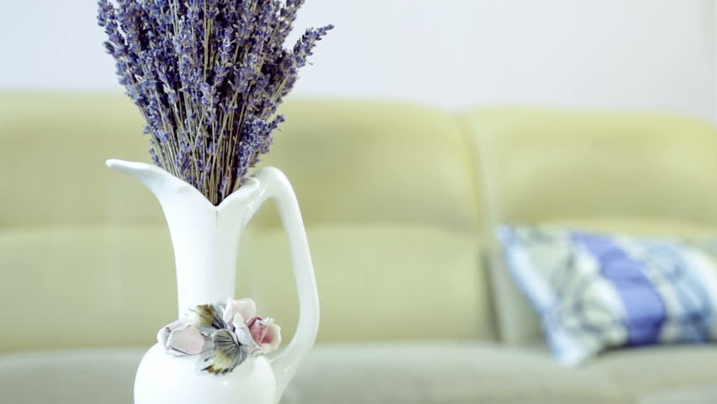
Grade Six Unit 9
Lesson 3 - S.B
page 73
Famous people

Slide 2


Slide 3
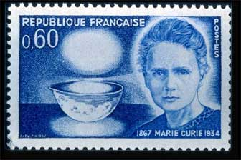
Why do you think her photo is on the stamp?
She was a scientist.

Slide 4





She was a bright child.

Slide 5



The Bright Child...
knows the answers
is interested
is attentive
works hard
answers the questions
is in the top group
listens with interest
learns with ease

Slide 6
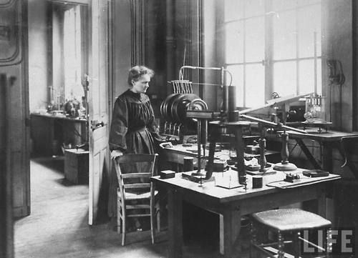
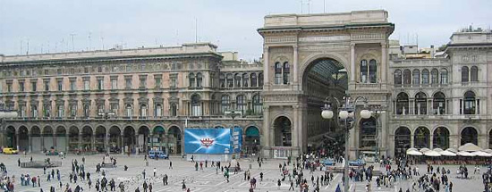
Do you think that she studied science at university?

Slide 7
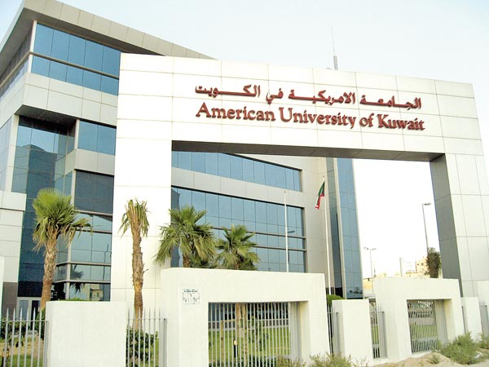
What would you like to study at university?

Slide 8

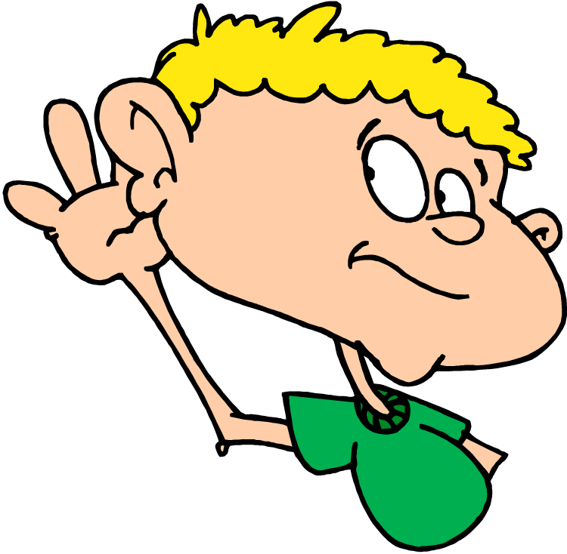
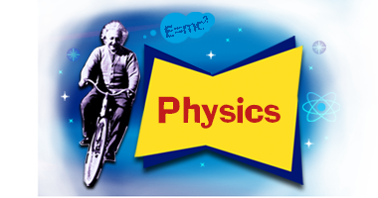
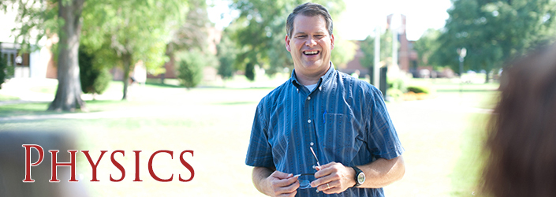
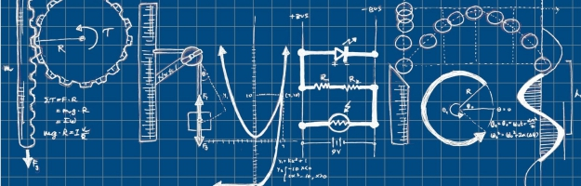
Read the word.

Slide 9
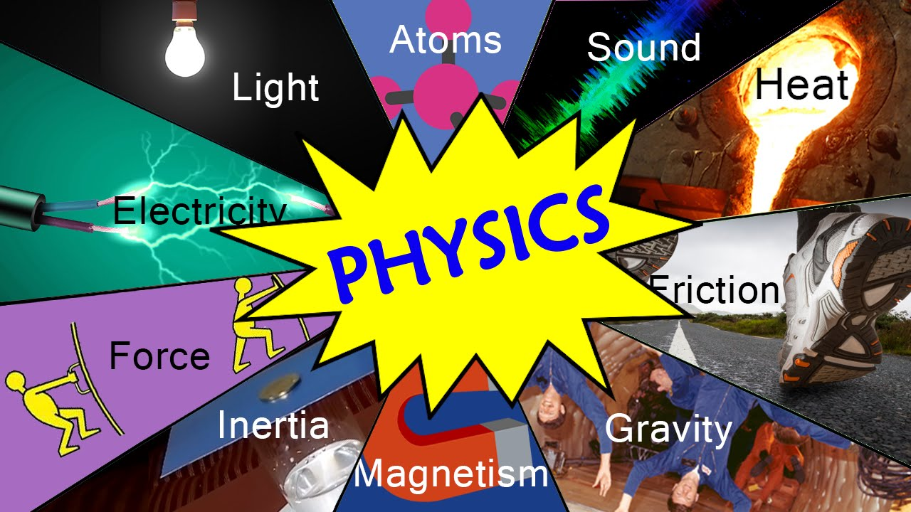
Physics is the study of heat and light and what they do to things.

Slide 10
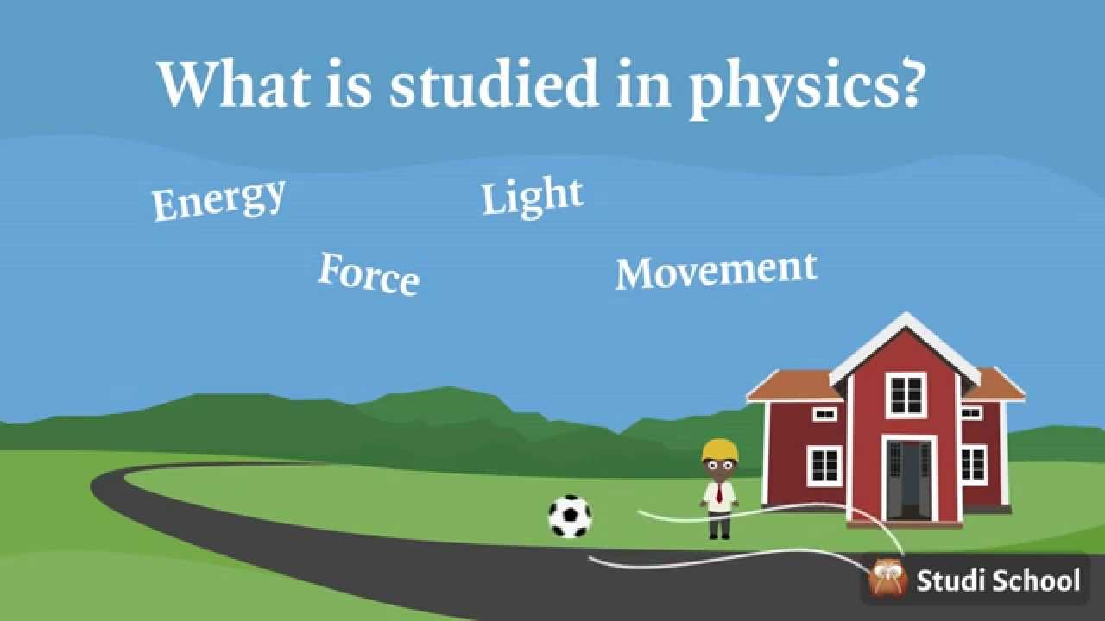
heat

Slide 11
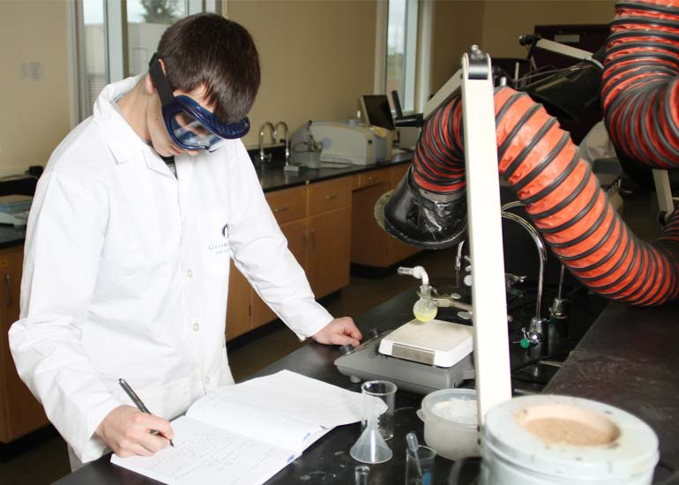
Would you like to study chemistry at university?

Slide 12
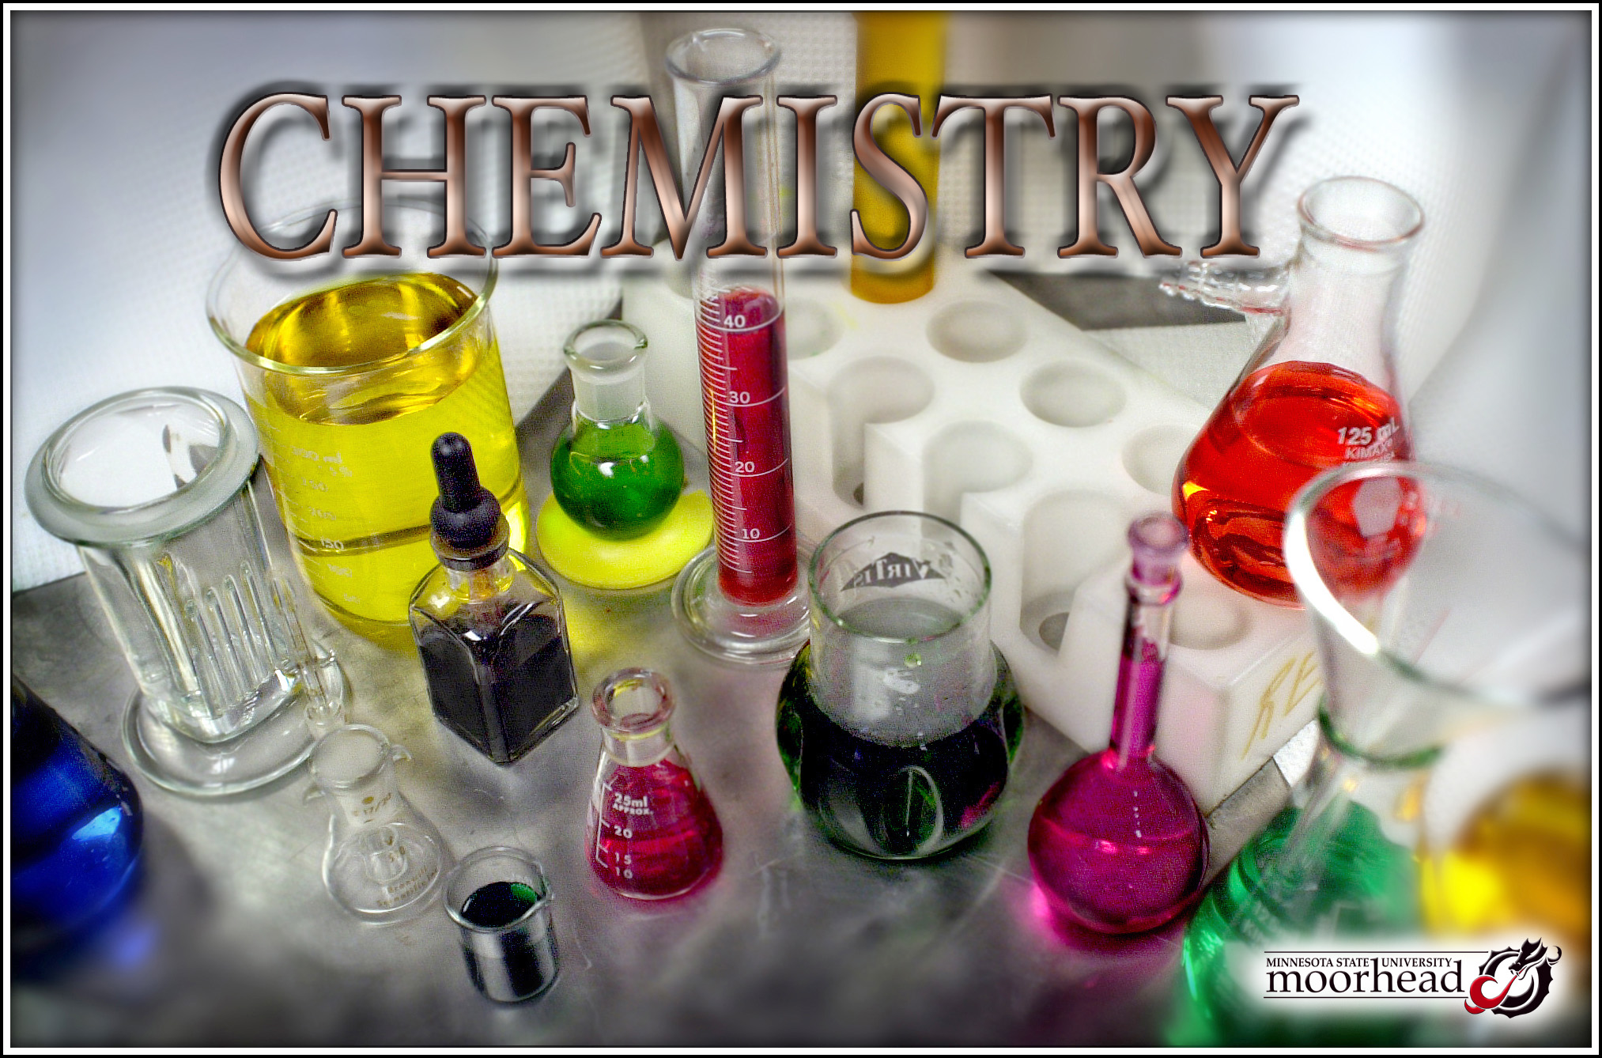
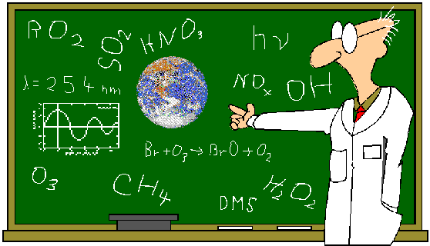
chemistry

Slide 13
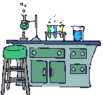
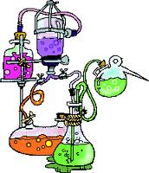
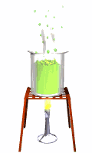
Chemistry is the study of how things are made and how they work together.

Slide 14
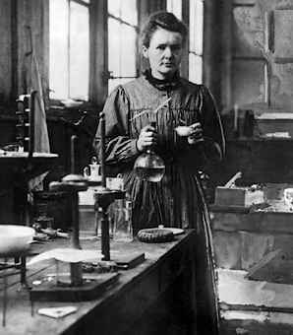
This great woman studied maths and physics at university.

Slide 15
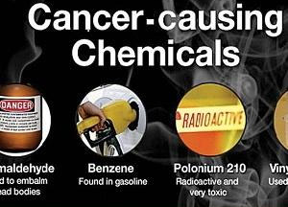

Some chemicals may cause fatal diseases.
Cancer is
a fatal disease.

Slide 16
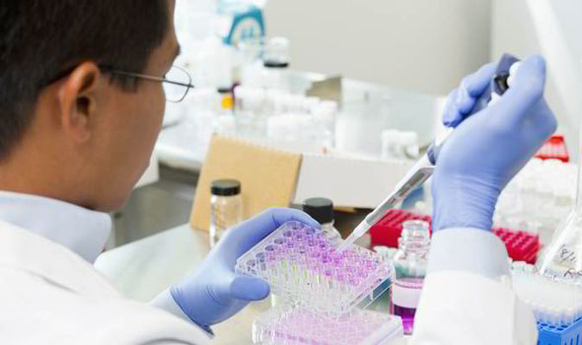
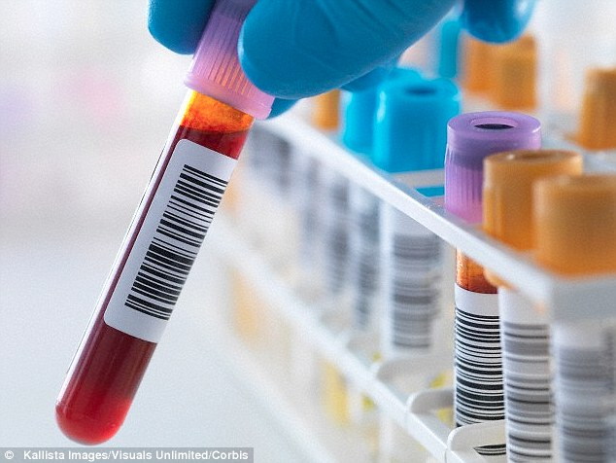
Chemistry is studied to cure diseases.

Slide 17
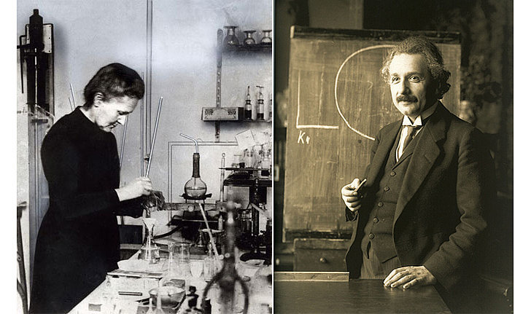
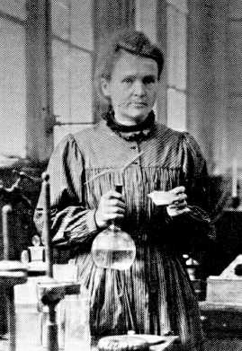

This woman did her best to
cure cancer.

Slide 18
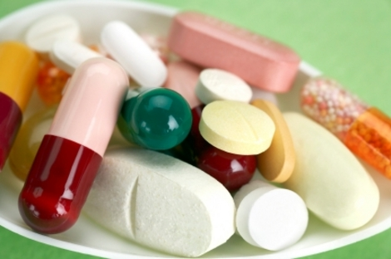
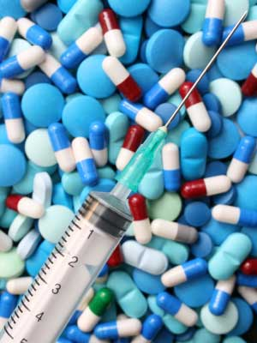
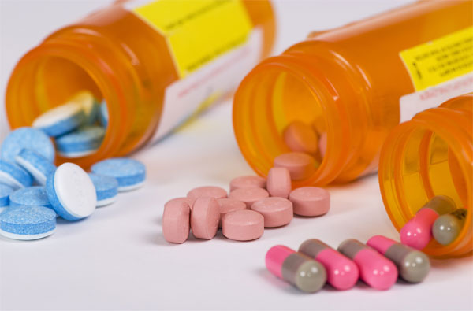
Doctors give ill people medicine to cure them.

Slide 19

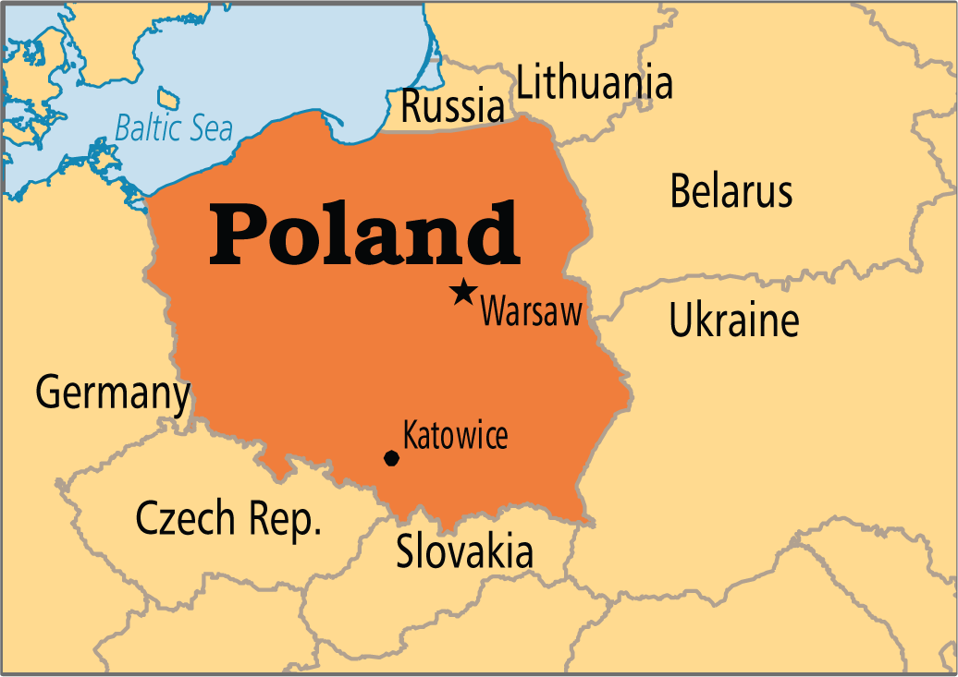
Where do you think the woman is from?

Slide 20

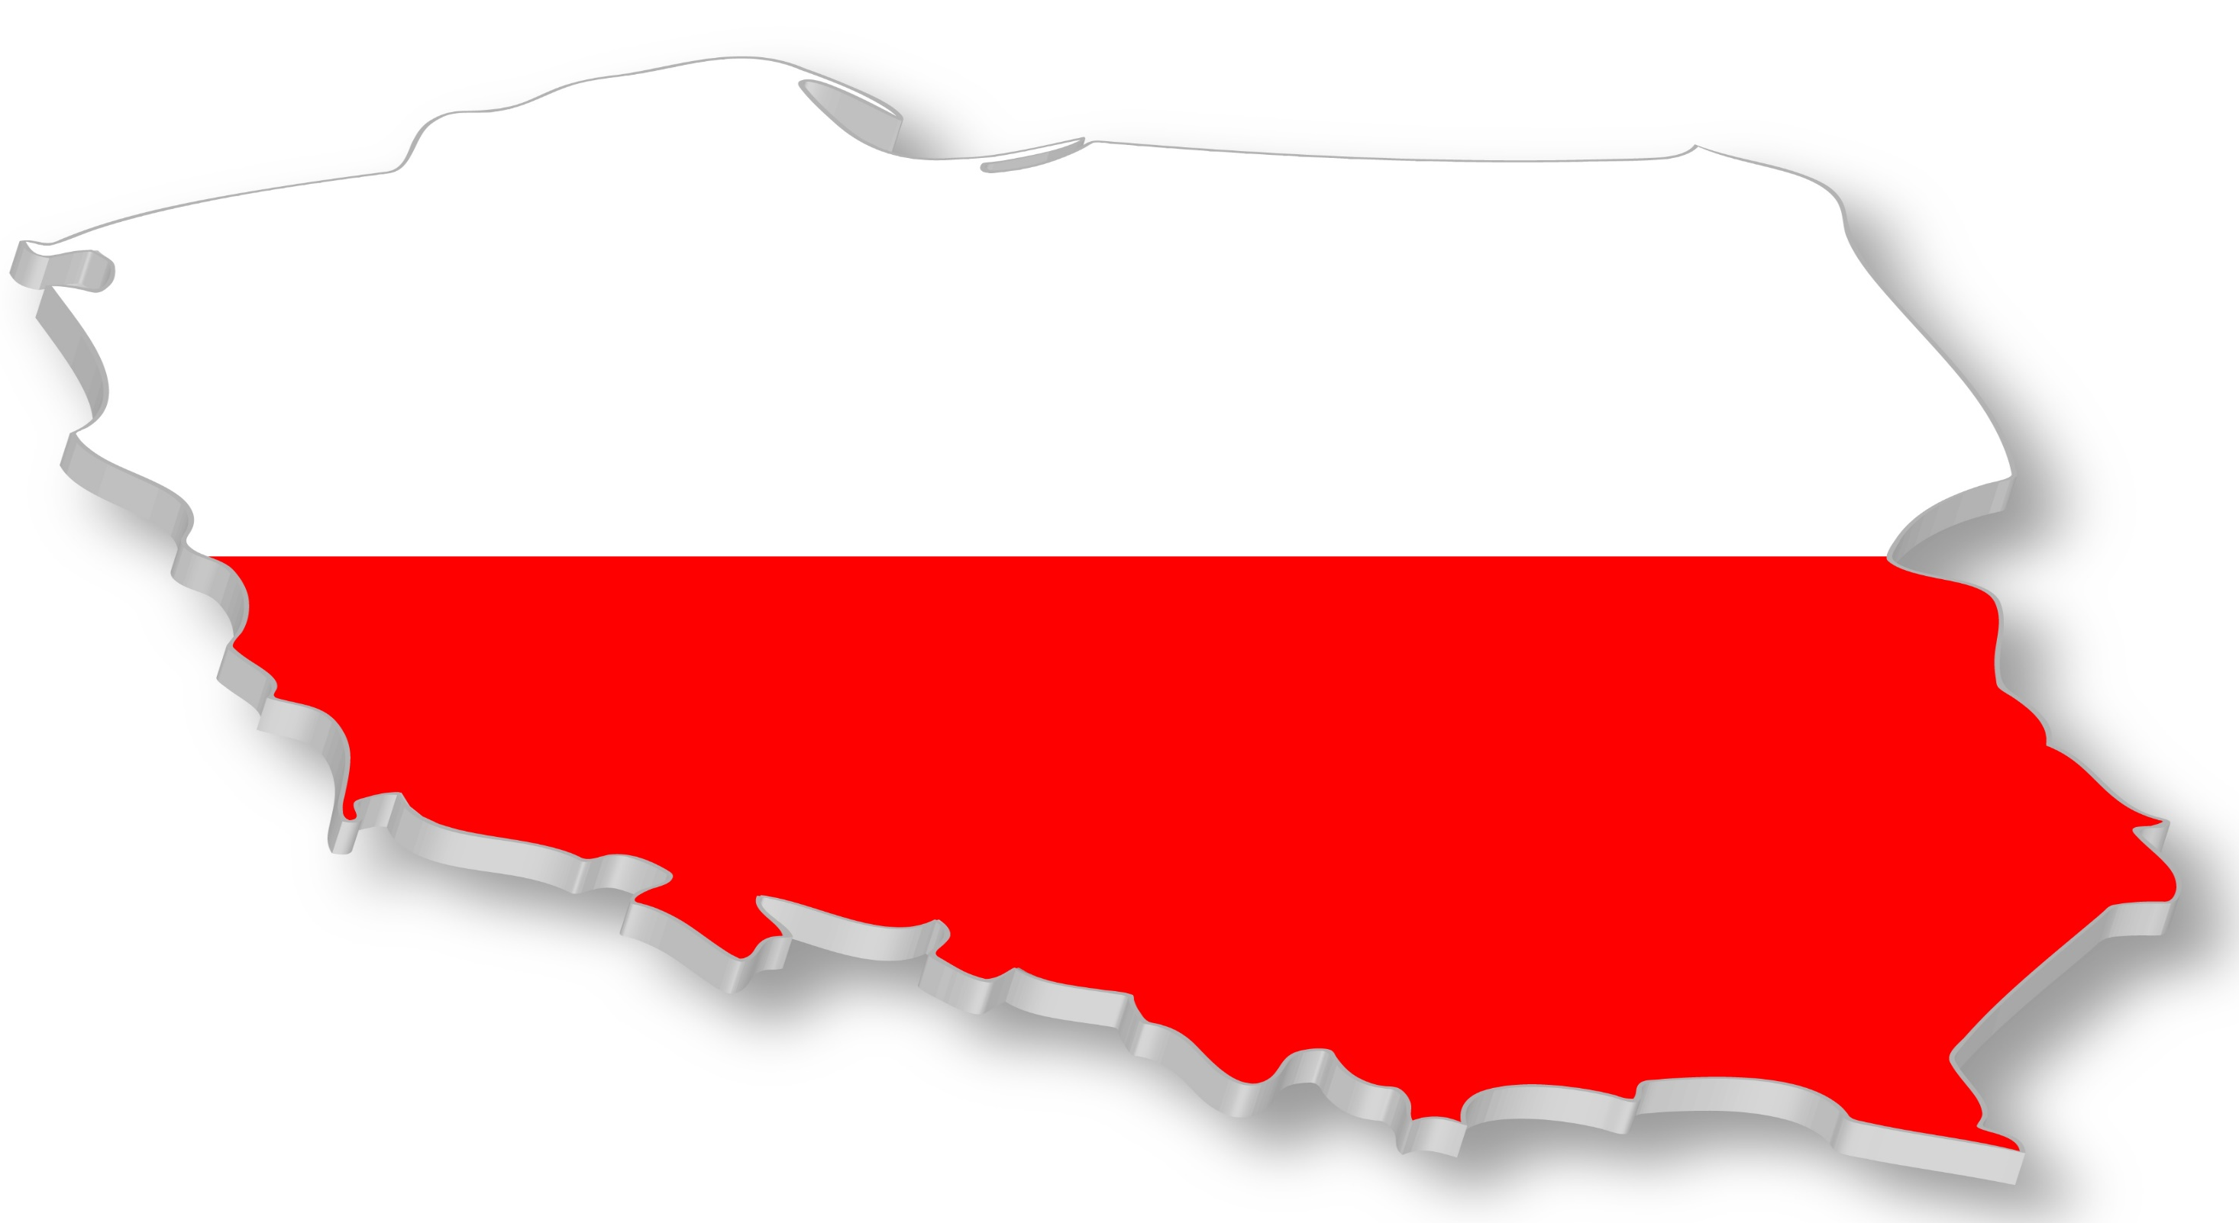

It wasn’t allowed for women to study at university in Poland.
So she travelled to Paris to study there.

Slide 21
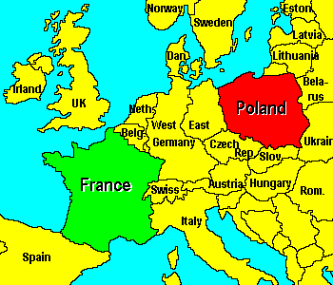

She studied abroad.

Slide 22




Slide 23
She met a scientist at university and married him.
marry

Slide 24

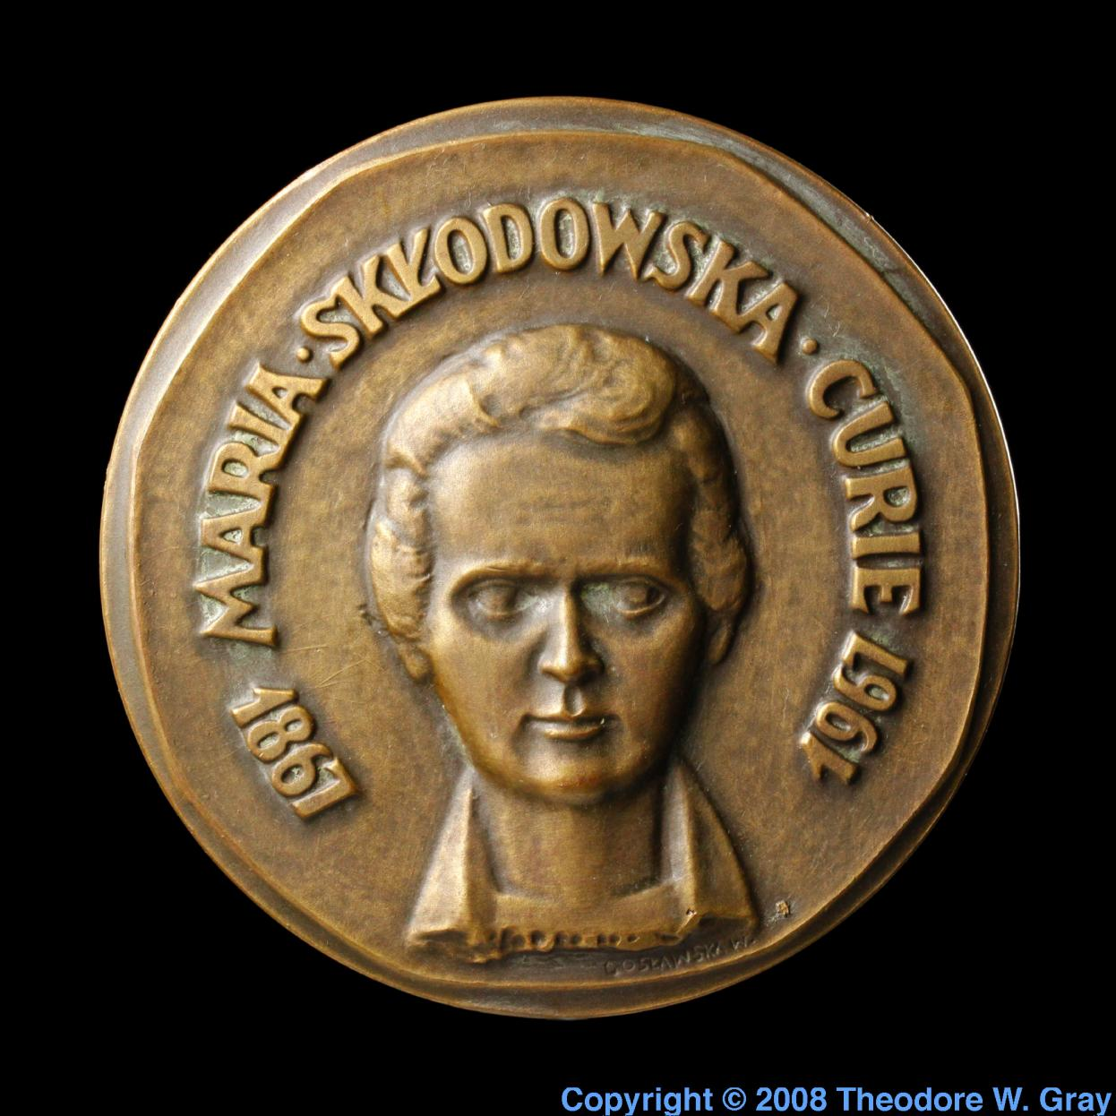

She won a prize for physics.

Slide 25


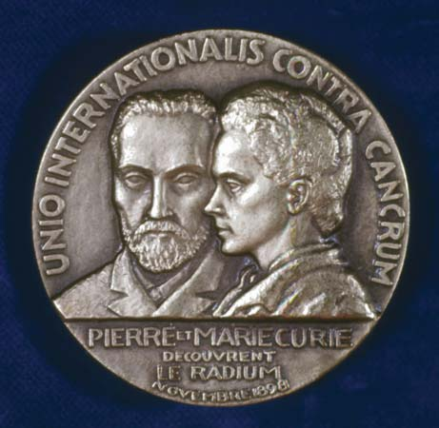


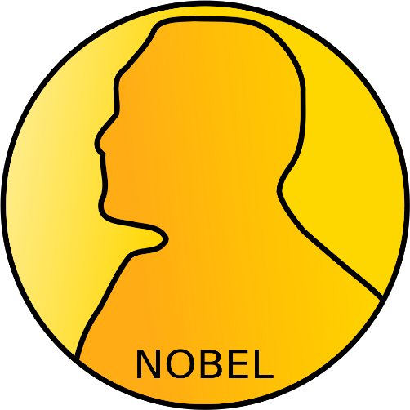
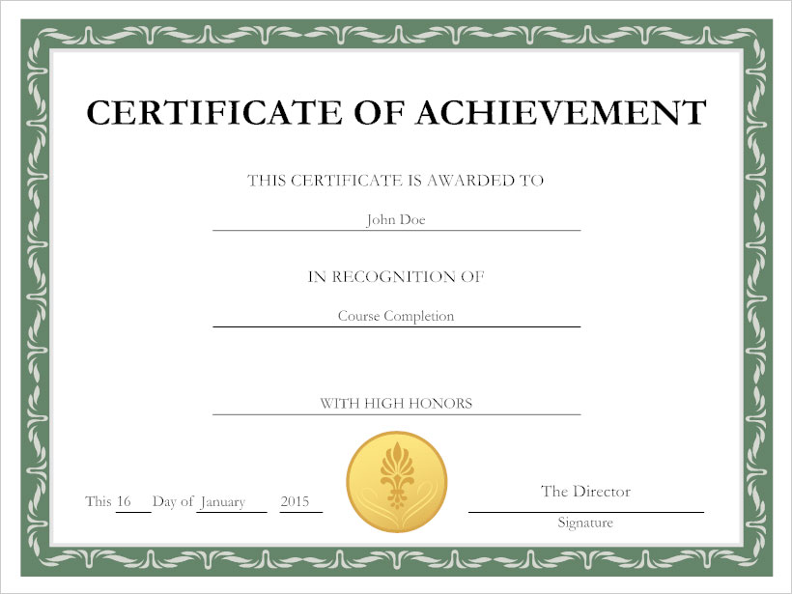
Also, she won another prize for chemistry.

Slide 26

She worked hard all her life to help people and cure cancer.

Slide 27

Sadly, she died of cancer.

Slide 28
Do you know the name of the great woman?
Her name is Marie Curie.

Slide 29
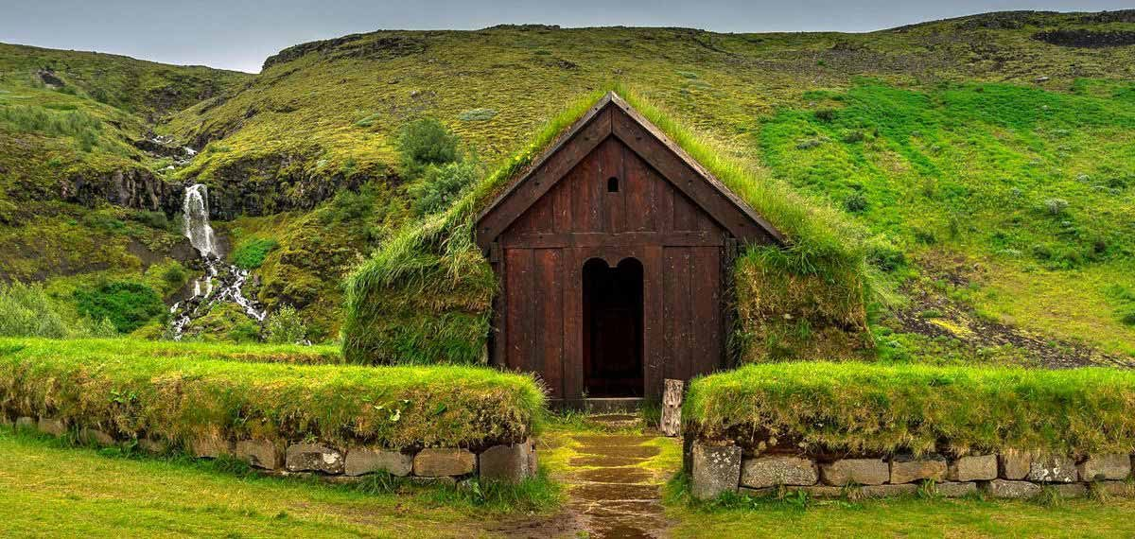


Look at the pictures and say the words.

Slide 30


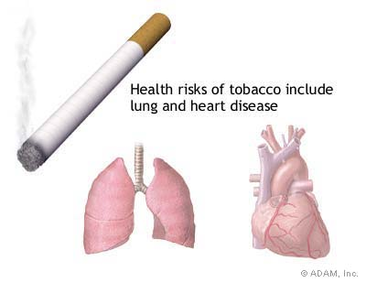


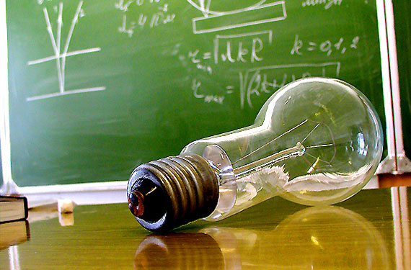
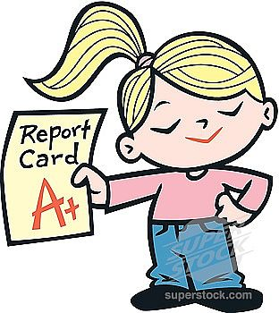
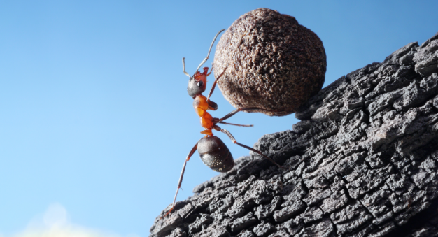
cancer (n.)
chemistry (n.)
cure (v.)
marry (v.)
physics (n.)
prize (n.)
sadly (adv.)
hard (adv.)
bright (adj.)
abroad (adv.)

Slide 31
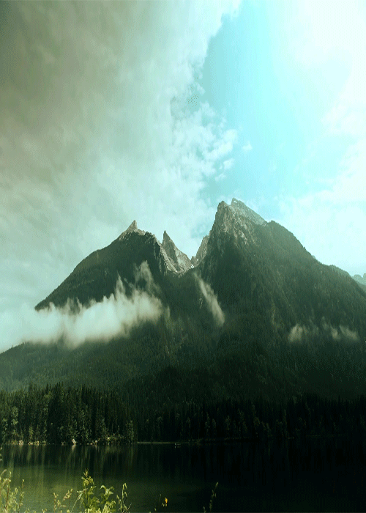
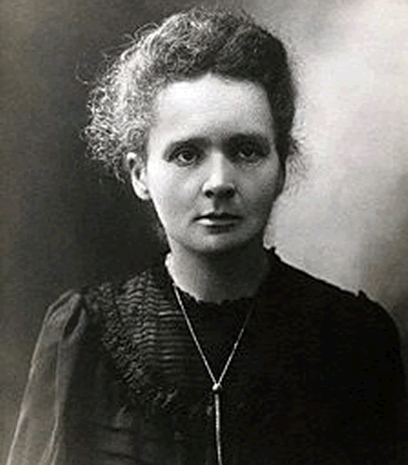
Student’s Book
Page 73
Marie Curie

Slide 32
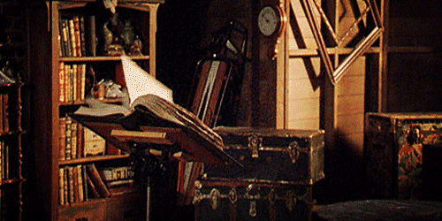


Slide 33
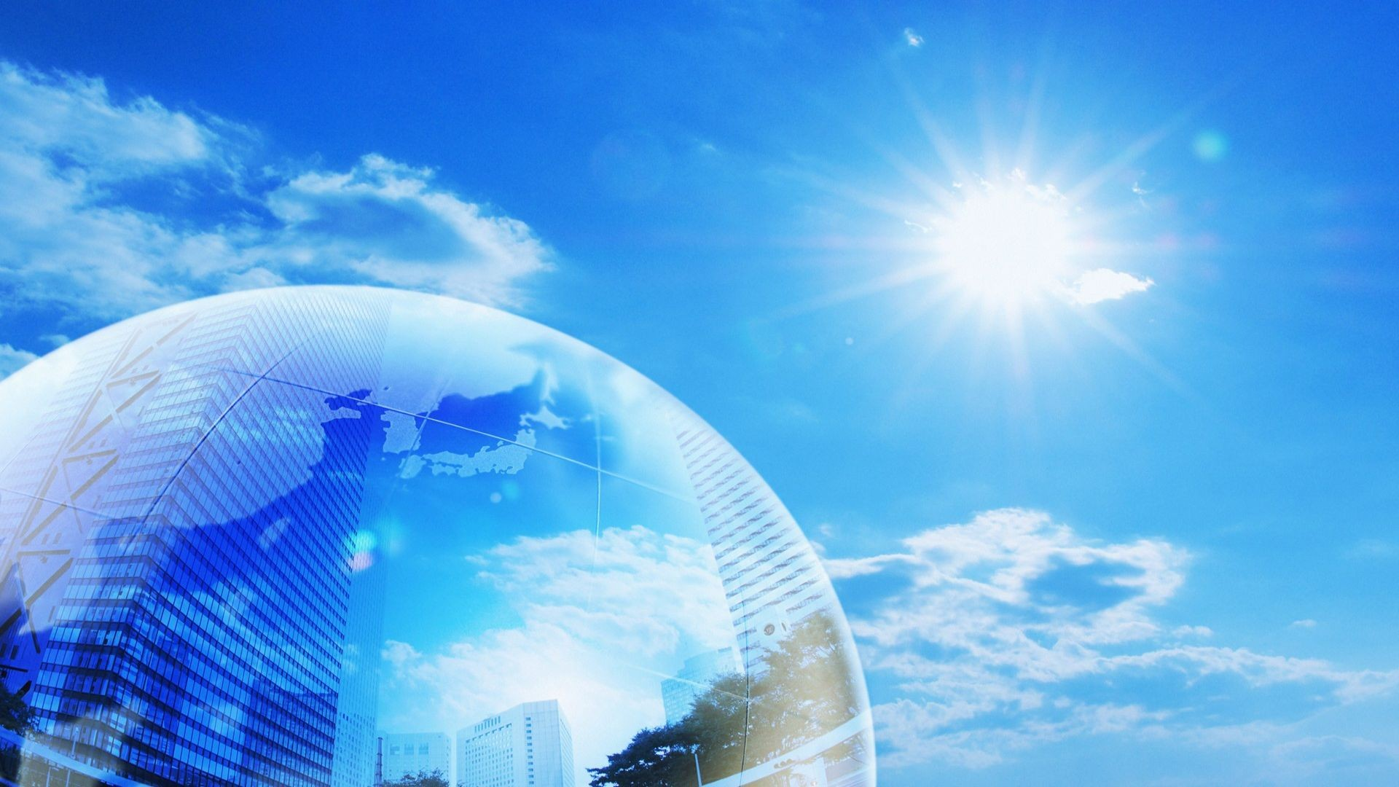

Slide 34




Slide 35
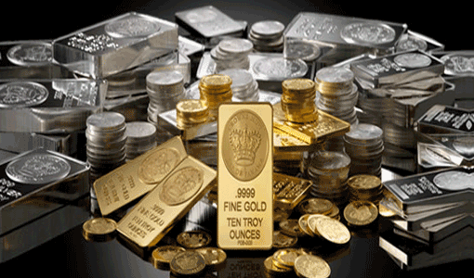
Check your answers.

Slide 36
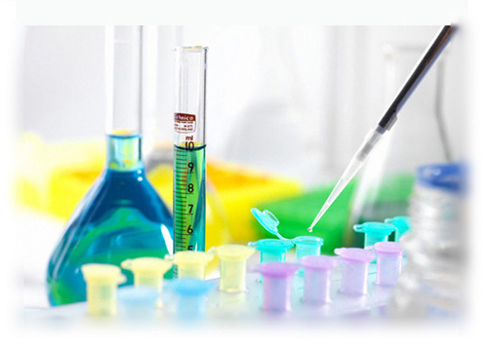
1- What is the main idea of the text?
a) Marie Curie studied Maths and Physics.
b) Marie Curie was a great scientist who saved lives.
c) Poland didn’t allow women to study at university.
d) Pierre Curie was a great scientist.

Slide 37
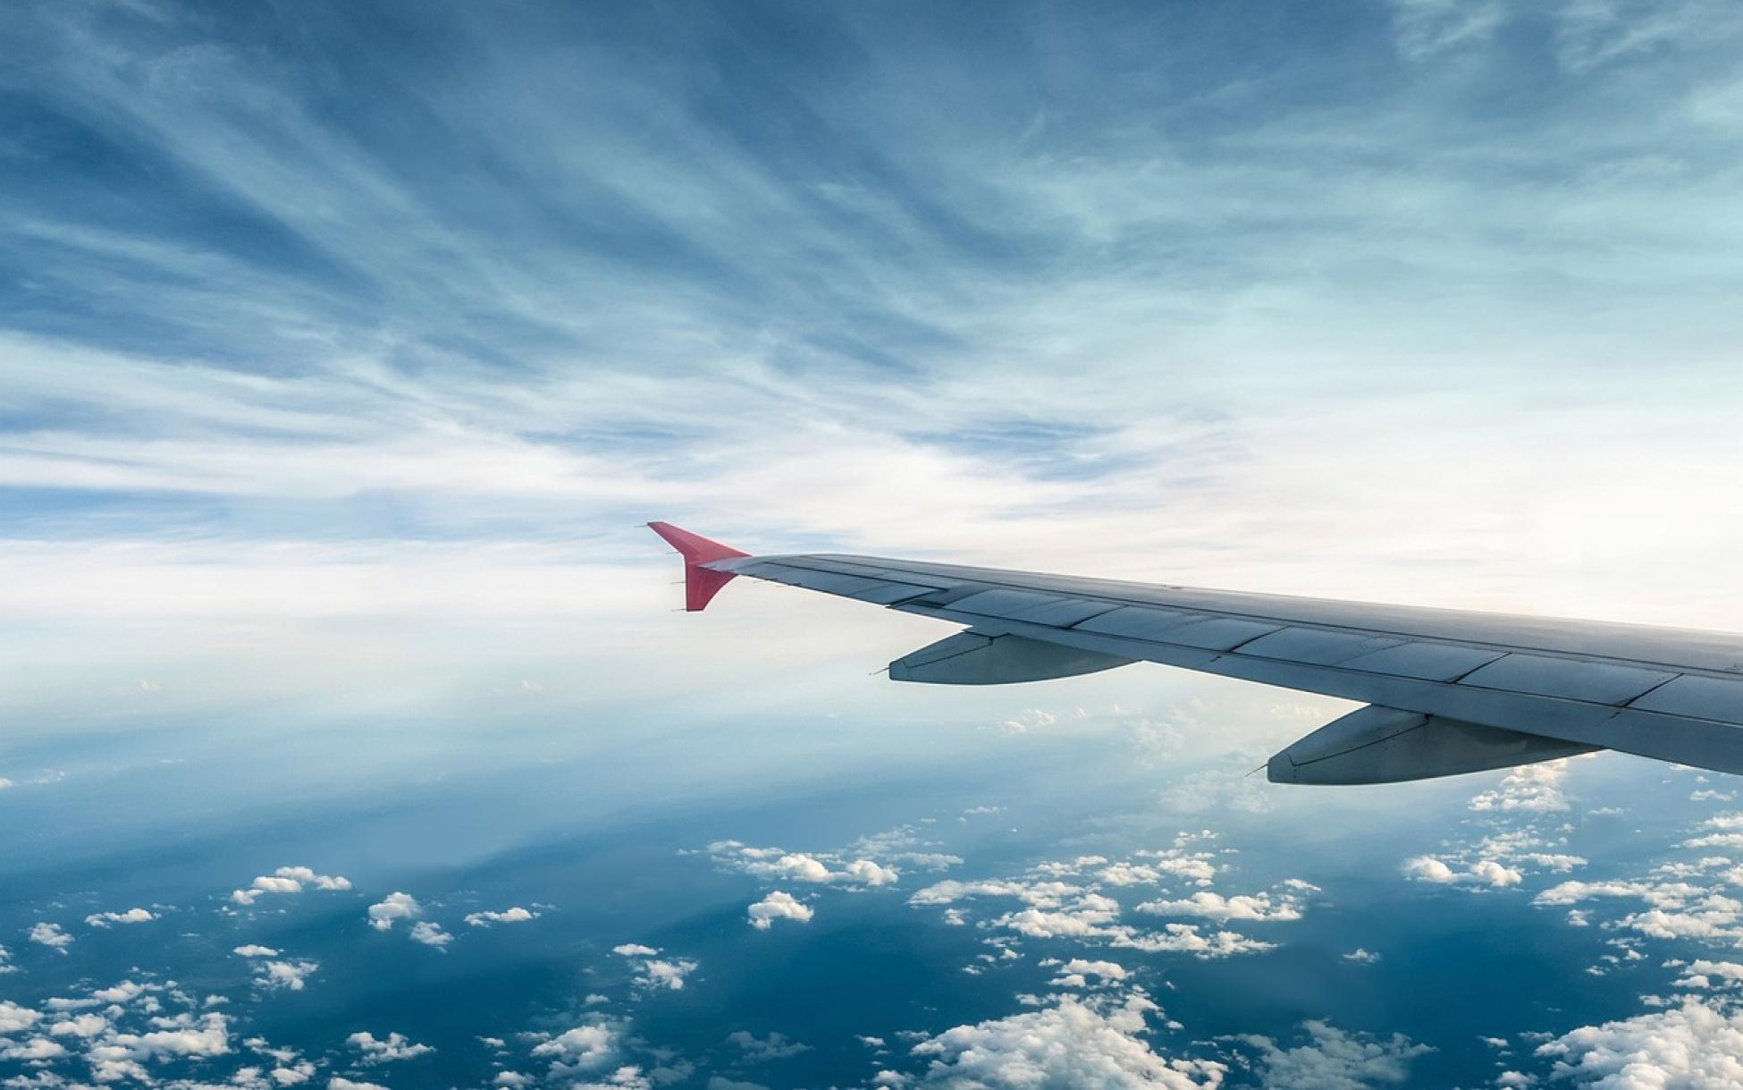
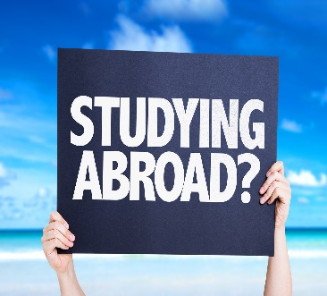
2- Why did Marie have to study abroad?
She had to study abroad because ---------------------------------.
a) There wasn’t any university in her country.
b) She didn’t want to study in her country.
c) Women weren’t allowed to go to university.
d) She met Pierre Curie and travelled with him.

Slide 38
In 1903, Marie and Pierre Curie were awarded the Noble Prize for physics. Winning the prize brought them fame.
3- What does the underlined word them refer to?
a) Marie Curie
b) Pierre Curie
c) physics
d) Marie and Pierre Curie

Slide 39
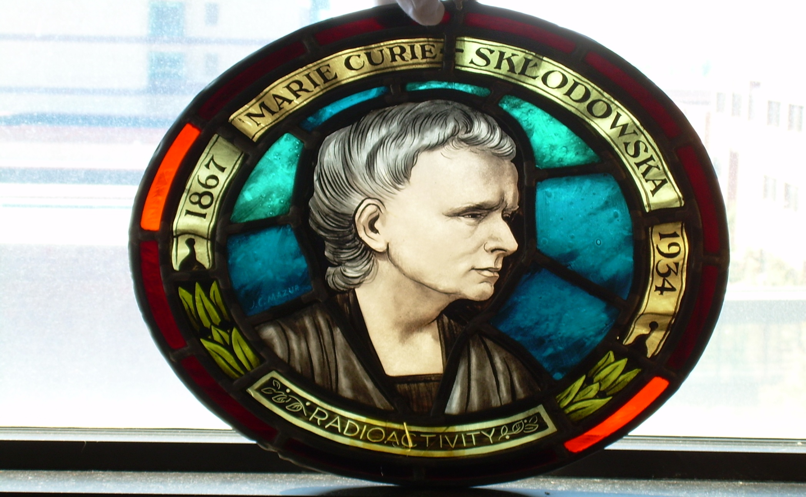

4- How old was she when she died?
When she died she was -----------------.
a) 76
b) 91
c) 67
d) 34
1934
1867
________
67

Slide 40
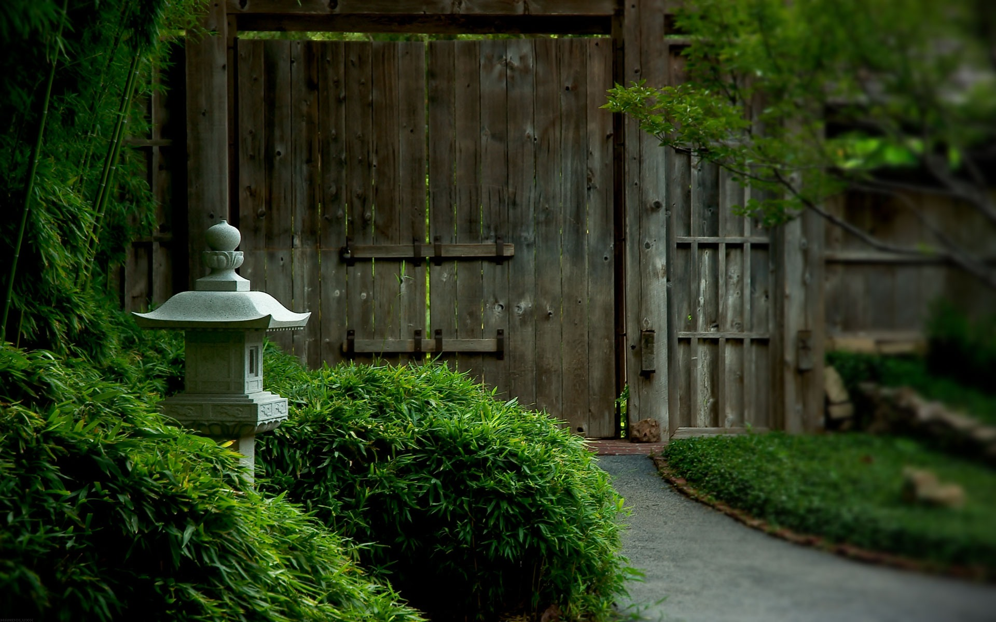
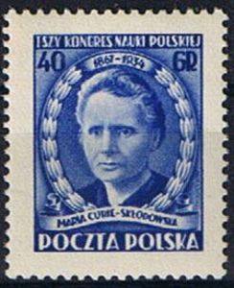
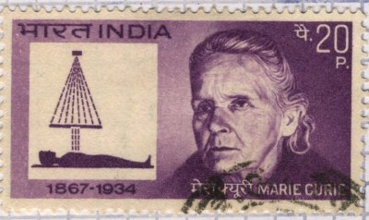

5- Why should she be on a stamp? Explain.
She should be on a stamp because --------------------------.
a) She died of cancer
b) She did something great and saved people’s lives
c) She was a scientist
d) She married a scientist

Slide 41



Slide 42
What work did Marie Curie’s mother and father do?
teachers

Slide 43

How many important prizes did she win?
TWO

Slide 44



